Slide 1



WTM Berlin
Android Study Jam
18th of October

Slide 2

Agenda
Intro
Talk + Live Demo
Designing an app: introduction to UX / UI design
Live Demo of Adobe XD
Q&A, self-learning and networking (aka don’t be shy)

Slide 3
Study Jam Structure
Follow the course at home.
Plan to finish Android Beginners around December. (6 Hours/Week)
Meetups:
Learn something that is not part of the course.
Ask for help to the organizers, coaches and other students.
Online:
Slack: #wtm-study-jam: Send Emojis and GIFs.

Slide 4

Female Tech Leads of Babbel
WTM Berlin will host a panel at Babbel
with some of the female tech leads of Babbel
26 October (meetup event in progress)

Slide 5

WTM Berlin invites: GOTO
Berlin: 14 - 16 November
Free tickets for GOTO Conference: bit.ly/wtm-berlin-goto
GOTO Berlin is an important conference in the IT world,
made "by developers for developers".
Also 20% discount for GOTO with the code:
NPISTUNOVICH_SPEAKERDISCOUNT

Slide 6

WTM Berlin in Codemotion
Berlin: 24 - 25 October
Two of our Women Techmakers attendees will present
our community in the Community Talks track!
Milan: 25 - 26 November
Free tickets for Milan Conference: Ask us if you can make it ;-)

Slide 7
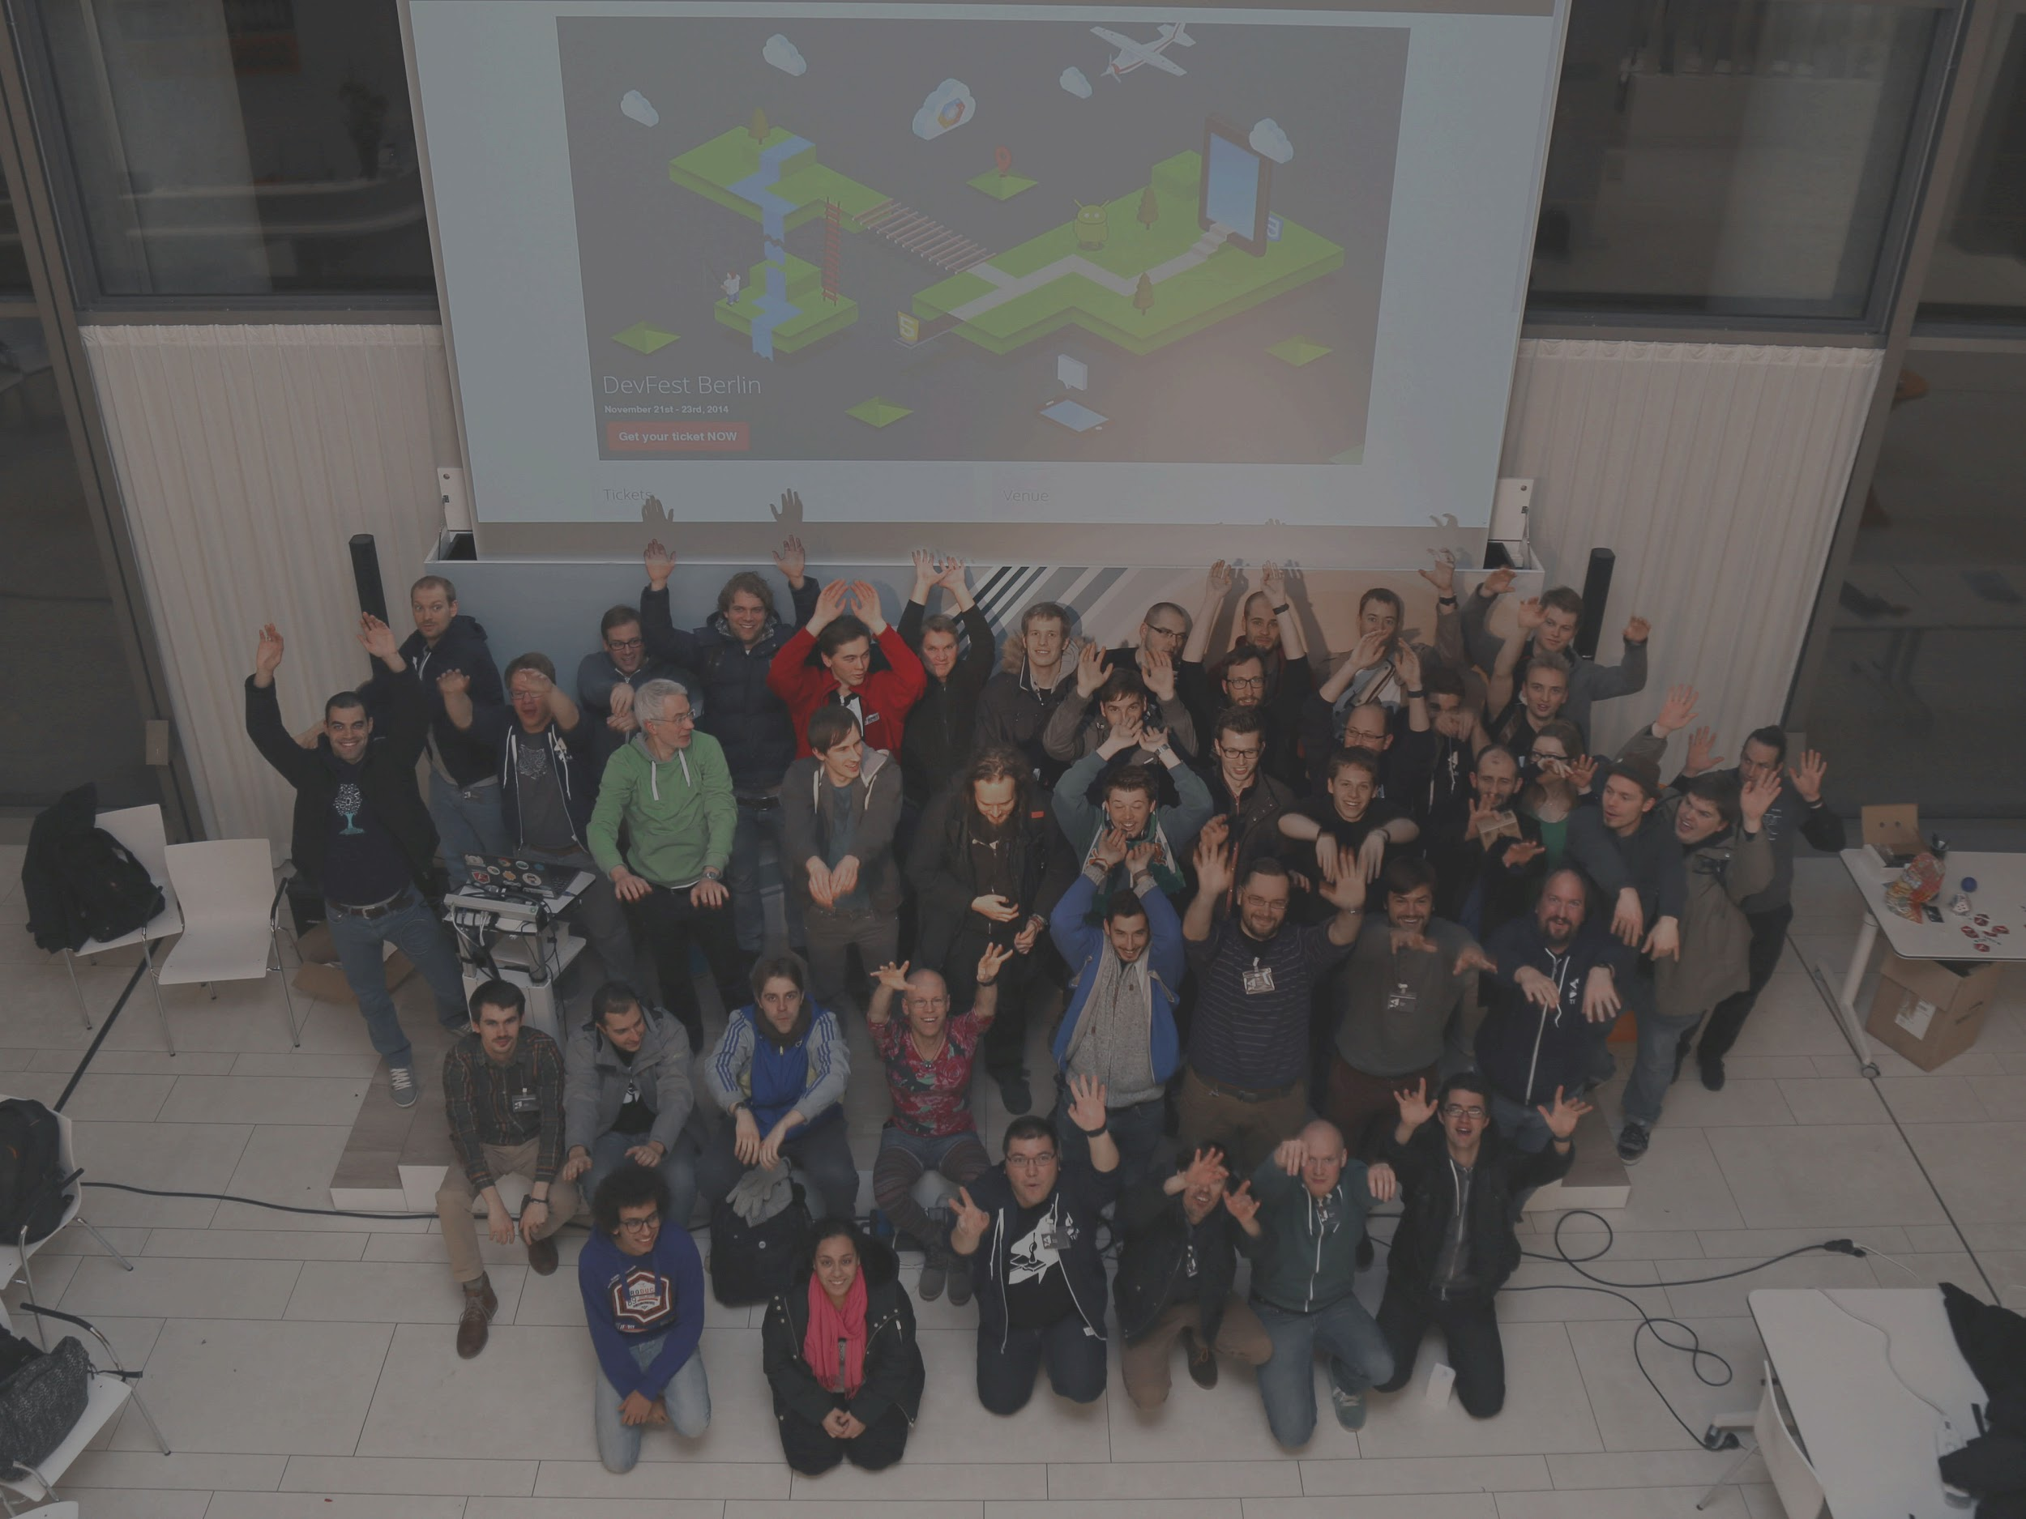


DevFest Berlin 2016 is coming!
November 11-12 @ ImmobilienScout24
Tickets on Sale!
https://2016.devfest-berlin.de/
Android, Web and Cloud talks and workshops
We <3 Beginners

Slide 8
DevFest Berlin 2016 is coming!
Apply for Mentorship program (in Diversity page)
We will match you with a Mentor
Apply for free diversity tickets (in Diversity page)
We are offering a free limited number of tickets for underrepresented groups.

Slide 9

Calendar android study jam
Sessions:
2016-11-01 - Code your Project!!!!1!
2016-11-22 (because DevFest)
2016-12-06
Beginners Graduation and project presentation
1st and 3rd Tuesday of the month @immobilienscout24 More details at the fb group, fb page and meetup

Slide 10
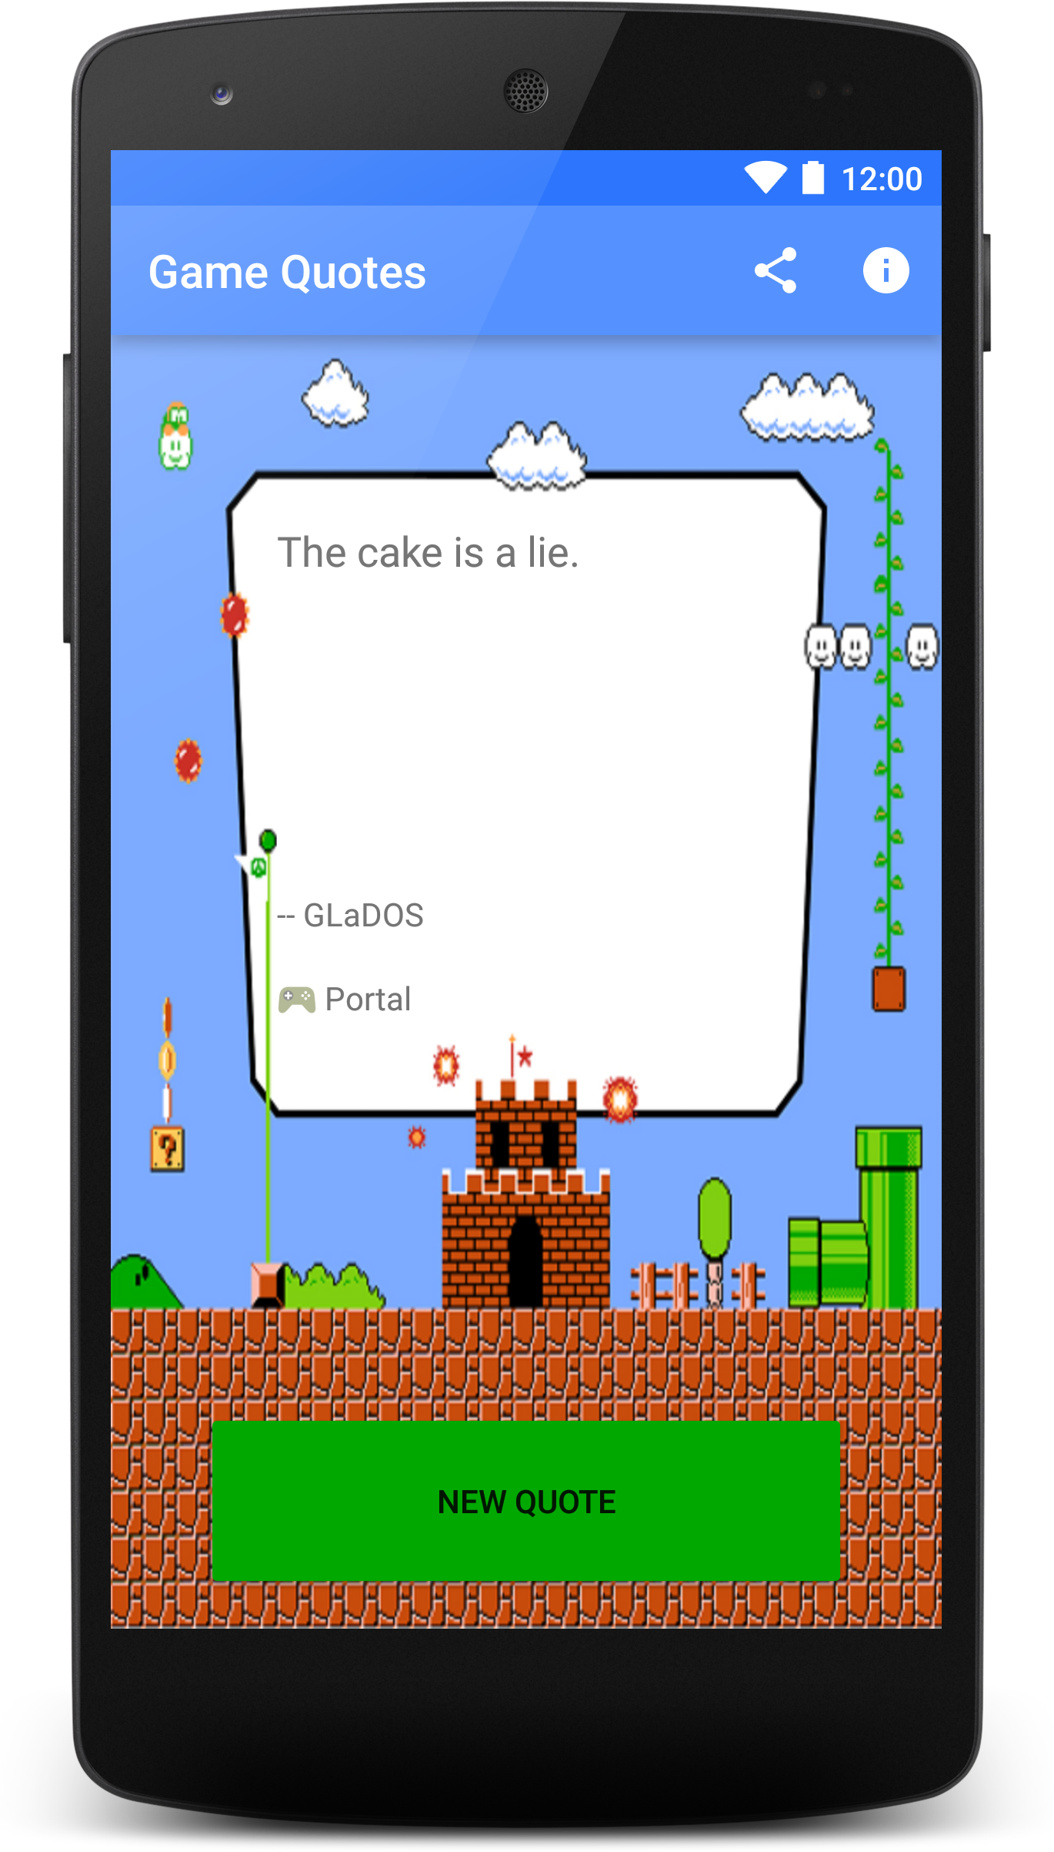
Beginners Projects
Single Screen App.
With things you learned at the course:
Layouts, ImageView, TextView, Buttons…
Open a browser, a location in Google Maps, a share intent...
Out Of Scope:
No storing things in phone
No network usage
Need ideas? Here’s some!
List of cool places to visit.
Quiz game.
Teach things to the user.
… or ask us!
Presentation: 2016-12-06

Slide 11

Getting on Slack
http://adg-berlin.herokuapp.com/
Join channel #wtm-study-jam
You are very welcome to join other channels as well!
Anyone needs help getting on Slack?

Slide 12

WIFI
SSID: WTM
PW: WTM_2016
please don’t share outside of meetup
tweet pics and ideas:
#WTMberlin

